Slide 1
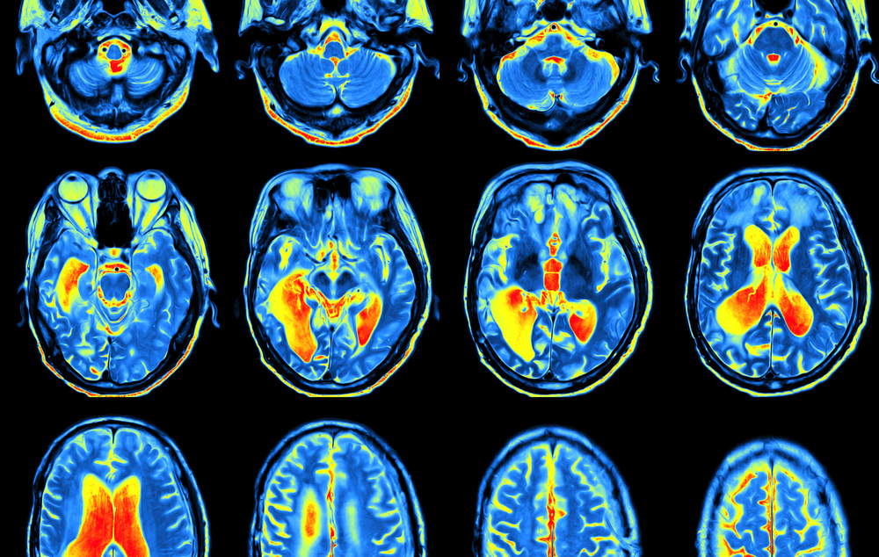

Positron Emission
Tomography
Luna Raithle
Heeyoun Lee
PET
BIOENG-310

Slide 2
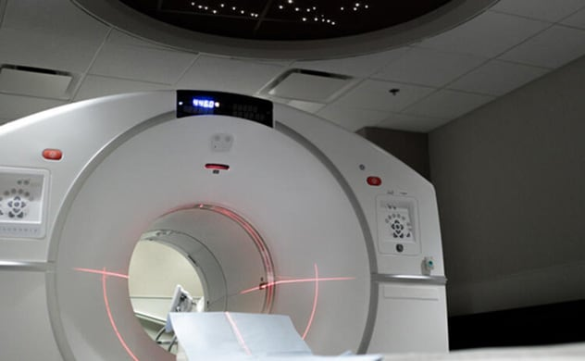
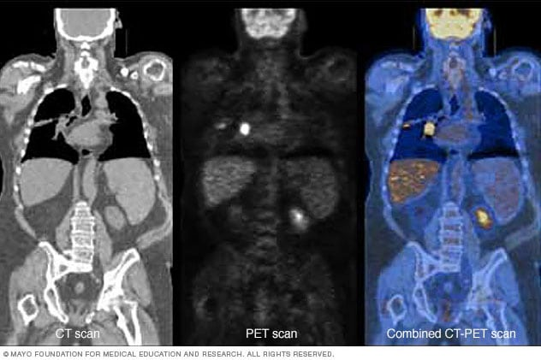
What is PET ?
<number>
Positron Emission Tomography
Medicine imaging technique
Detects metabolic activity by tracing radioactive substances (tracers)
Can detect unusual energy use in the body before the disease shows up on other imaging tests (CT, MRI, …)
Helps discover cancer, heart disease and brain disorders
BIOENG-310 / PET
CT PET CT-PET

Slide 3
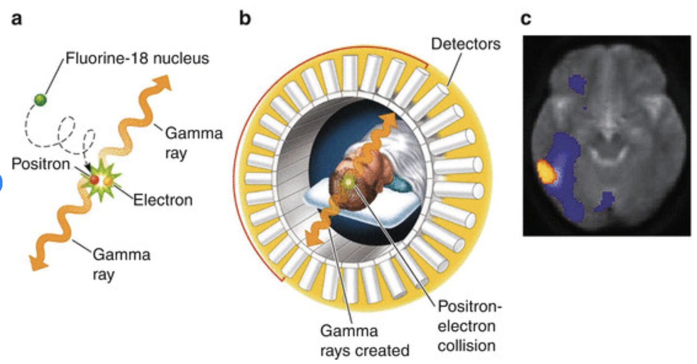
How it works
<number>
A radioactive drug called a tracer is injected into the bloodstream
Cancer cells and brain cells use lots of energy
Fluorodeoxyglucose (FDG) is a widely used PET tracer (brain) → acts like glucose
BIOENG-310 / PET

Slide 4
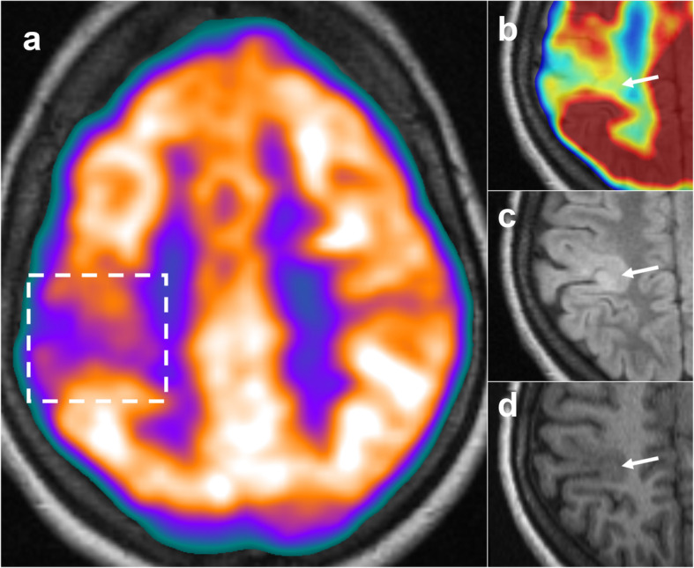
PET Clinical Application - Epilepsy
<number>
FDG-PET detects interictal hypometabolism matching EEG abnormalities.
FDG-PET is impractical for real-time seizure imaging in clinical settings due to slow update of FDG
PET-MRI Coregistration combines PET’s functional data with MRI’s structural detail
PET-MRI Coregistration is useful when there are no visible abnormalities on MRI.
BIOENG-310 / PET
Notes:
One of the clinical Application of PET scan is detecting Epilepsy.
FDG-PET detects inter-ictal hypometabolism—areas where glucose use drops between seizures.
Those cold spots often match the abnormal EEG electrodes we see during monitoring. Because FDG uptake changes slowly, PET isn’t ideal for real-time seizure capture, but it is very useful when we co-register it with MRI.
Coregistration means combining PET and MRI images by overlaying PET image and MRI image. This also helps doctors find the exact spot in the brain where seizures start
In panel (a), we see a fused image of PET and MRI. The colored area represents glucose metabolism, and the dashed box highlights a region of interictal hypometabolism—a common marker for the zone where the seizures start.
Panel (b) zooms in on this area using a color map to clearly show the reduced activity.
Panels (c) and (d) show the same region on standard MRI. They are slightly brighter or darker, but it is not enough to make a conclusion
By combining PET and MRI, we can see both function and structure together, making it easier to pinpoint the seizure focus—even when the MRI looks nearly normal.
<number>

Slide 5
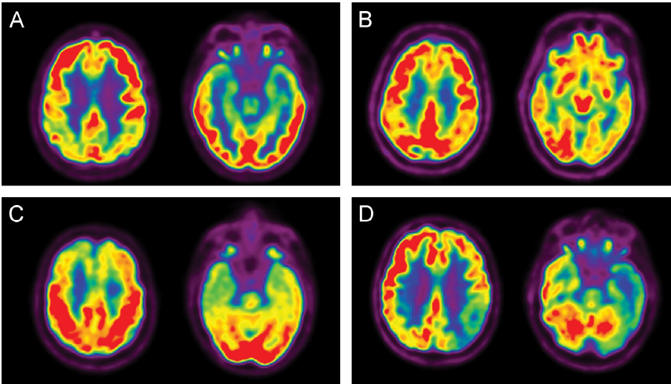
PET Clinical Application - Dementia
<number>
FDG-PET measures glucose metabolism in the brain and reveals different patterns of hypometabolism depending on the type of dementia.
BIOENG-310 / PET
A | Alzheimer’s Disease (AD) | Parietotemporal + posterior cingulate hypometabolism
B | Dementia with Lewy Bodies (DLB) | Occipital hypometabolism
C | Frontotemporal Lobar Degeneration (FTLD) | Frontal / anterior temporal hypometabolism
D | Vascular Dementia | Asymmetric + subcortical involvement
Notes:
When a spot uses less sugar, it means the brain cells there are slowing down or dying.
Different kinds of dementia slow down different parts of the brain. In this photo, it shows different patterns of hypometabolism depending on the dementia type. So, a single 20-minute FDG-PET scan can sort out four very different dementias. This is something neuropsych testing or structural MRI alone often can’t do.
There are newer tracers other than FDG, like amyloid and tau tracers. Let’s see how newer PET tracers can tell us even more
<number>

Slide 6
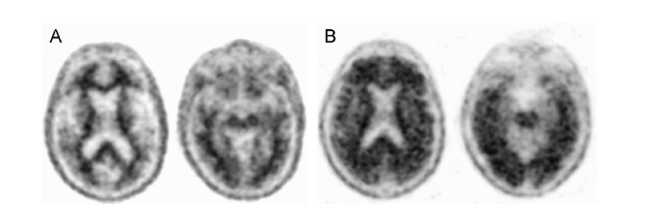
Amyloid Imaging
<number>
Accumulation of amyloid plaque is main characteristic of Alzheimer’s disease
Useful for unclear MCI or atypical Alzheimer's
Binary Interpretation
22–30% of cognitively normal people over age 60 also show amyloid plaque on PET scans
Amyloid PET are useful for detecting early pathological changes in Alzheimer's even before symptoms appear
FDG-PET is better for predicting how quickly symptoms may worsen
Notes:
PET can be also used for the Amyloid Imaging.
Even though the cause of the Alzheimer's disease is not known, Accumulation of amyloid plaque is main characteristic of if.
PET is especially useful for when the progressive MCI(Mild Cognitive Impairment) is unclear or atypical Alzheimer's is suspected.
Florbetapir is the agent currently used for Amyloid Imaging.
Florbetapir PET scans are used with a binary interpretation, If there is little or no amyloid detected in the brain, it is negative.
If there is clear amyloid accumulation in at least two brain regions, it is positive.
In this slide, A is a negative case with low cortical uptake of the tracer so the gray-white matter boundaries are clearly visible. On the other hand B is a positive scan. Here the cortical tracer uptake is diffuse and the distinction is blurred
<number>

Slide 7

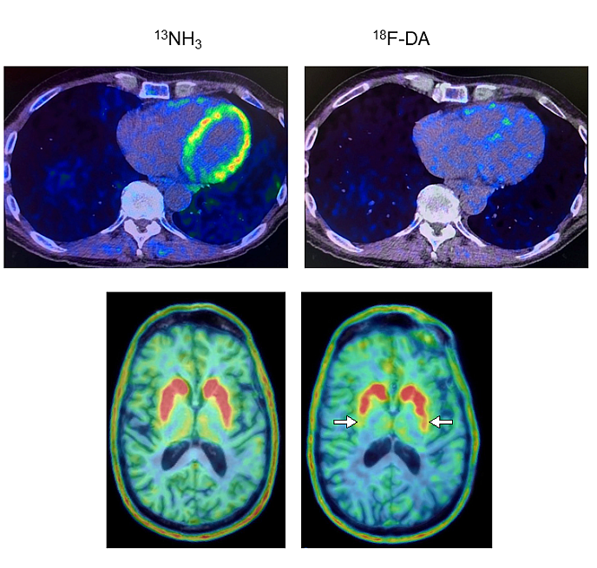
The Next Frontier of PET - Parkinson Disease
<number>
Heart PET scans may help identify Parkinson’s disease before symptoms appear
Low levels of dopamine linked to Parkinson's disease
Disease processes may not begin in the brain
BIOENG-310 / PET
Decrease activity of dopamine

Slide 8
The Next Frontier of PET - Traumatic Brain Injury
<number>
TBI involves both acute and chronic brain damage from external trauma.
In acute phase, PET can show hypometabolism even when MRI appears normal.
PET detects functional brain abnormalities early
BIOENG-310 / PET
Notes:
Traumatic brain injury is hard to see on routine scans. Again, PET gives us extra information that MRI alone can miss.
There are two phase in TBI, the accute phase, which is the first hours to days after the impact and the Chronic phase which is weeks to years later.
Early FDG-PET often shows hypometabolism—areas using less glucose—even when the MRI looks normal.
These low-activity zones can flag tissue that is stressed but not yet permanently damaged.
In longer term, FDG-PET can confirm which regions still have reduced metabolism and may explain lasting symptoms.
<number>

Slide 9
Conclusion
<number>
PET is a powerful imaging tool that shows how the brain works, not just how it looks
FDG-PET is widely used to diagnose neurological diseases like Alzheimer’s, Parkinson’s, and brain tumors
PET makes invisible diseases visible — early, clearly, and functionally
BIOENG-310 / PET
Notes:
Positron-emission tomography, or PET, lets us see how the brain works, not just how it looks.
With the glucose tracer FDG we already:
spot seizure zones in drug-resistant epilepsy,
separate different types of dementias,
and guide treatment in brain tumours and other disorders
In each case PET turns problems that are invisible on routine scans into clear targets.
By combining PET and MRI, we can obtain earlier diagnosis, better planning, and, we hope, better outcomes.
<number>

Slide 10
Sources
<number>
https://alzheimersnewstoday.com/news/fdg-pet-scan-accurately-assesses-cognitive-decline-severity-alzheimers-disease/
https://www.mayoclinic.org/tests-procedures/pet-scan/about/pac-20385078#:~:text=For%20your%20PET%20scan%2C%20a,from%20the%20radiation%20is%20low.
https://www.researchgate.net/figure/Positron-emission-tomography-PET-a-Molecules-with-radioactively-labeled-probes-are_fig10_259294193
https://www.sciencedirect.com/topics/medicine-and-dentistry/brain-positron-emission-tomography
https://www.nih.gov/news-events/news-releases/pet-scans-may-predict-parkinson-s-disease-lewy-body-dementia-risk-individuals
https://pmc.ncbi.nlm.nih.gov/articles/PMC8218059/#:~:text=Open%20in%20a%20new%20tab

